Slide 1

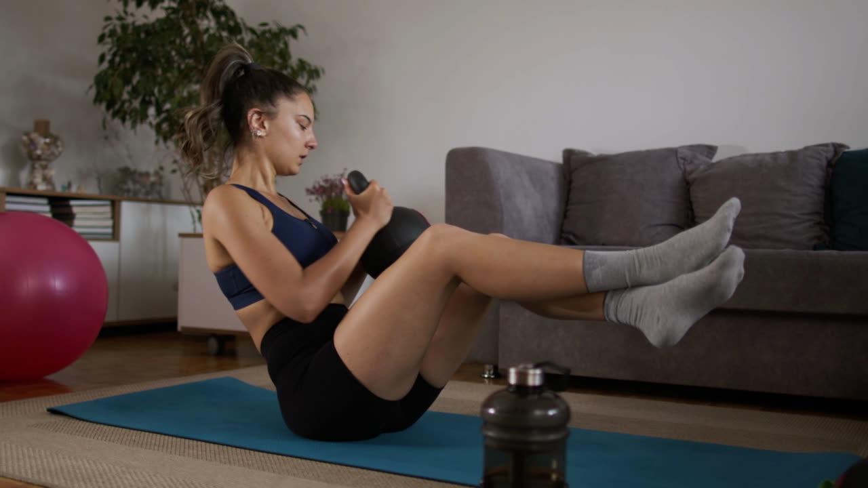


AI-POWERED FITNESS TRAINER

Slide 2
Contents
1
Inroduction
2
Problems
3
Project Goal
4
Project Stages
5
Potential Future Features

Slide 3
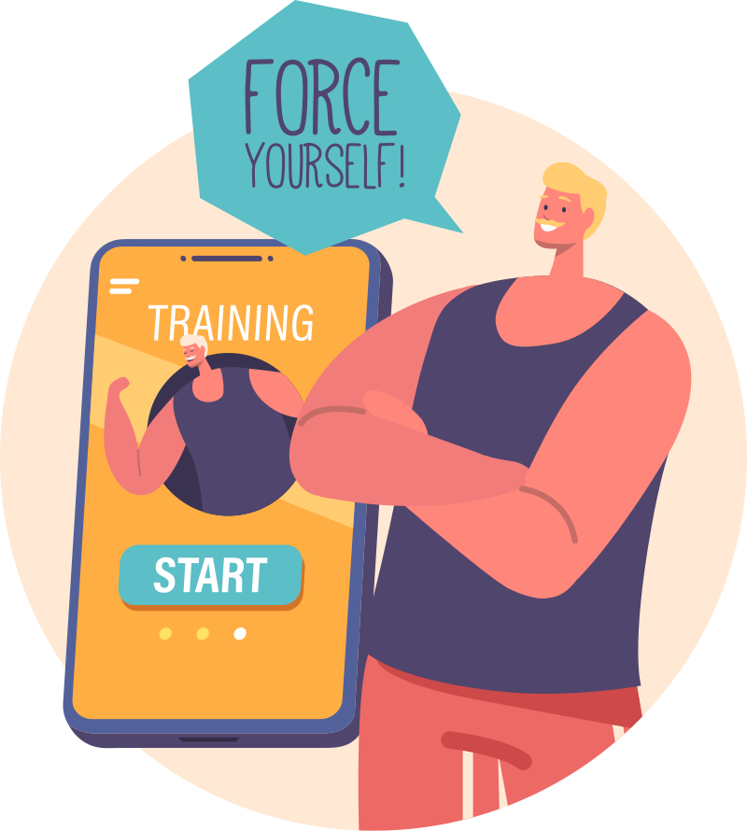

Introduction
The AI-Powered Fitness Trainer leverages advanced technologies such as real-time pose estimation and movement analysis to provide users with personalized, immediate feedback during their workouts. By analyzing users' movements through video analysis, the system can accurately assess their exercise form, identify any errors or misalignments, and deliver corrective guidance instantly.

Slide 4
The Problem
Improper Exercise Form
Many people struggle to maintain correct form, leading to ineffective workouts and poor results.
Incorrect form increases the risk of injury, which can hinder fitness progress and cause long-term issues.
Risk of Injury
Lack of Personalized Coaching
Personal trainers can be expensive and inaccessible, leaving individuals without personalized guidance.
Most fitness apps provide feedback only after workouts, missing the chance to correct mistakes during exercises.
No Real-Time Feedback

Slide 5


Our project aims to revolutionize personal fitness by making professional-quality training accessible to everyone, anywhere, and at any time. With the ability to monitor workouts in real-time, our AI system not only helps users improve their techniques but also reduces the risk of injury and enhances overall workout effectiveness.

Slide 6
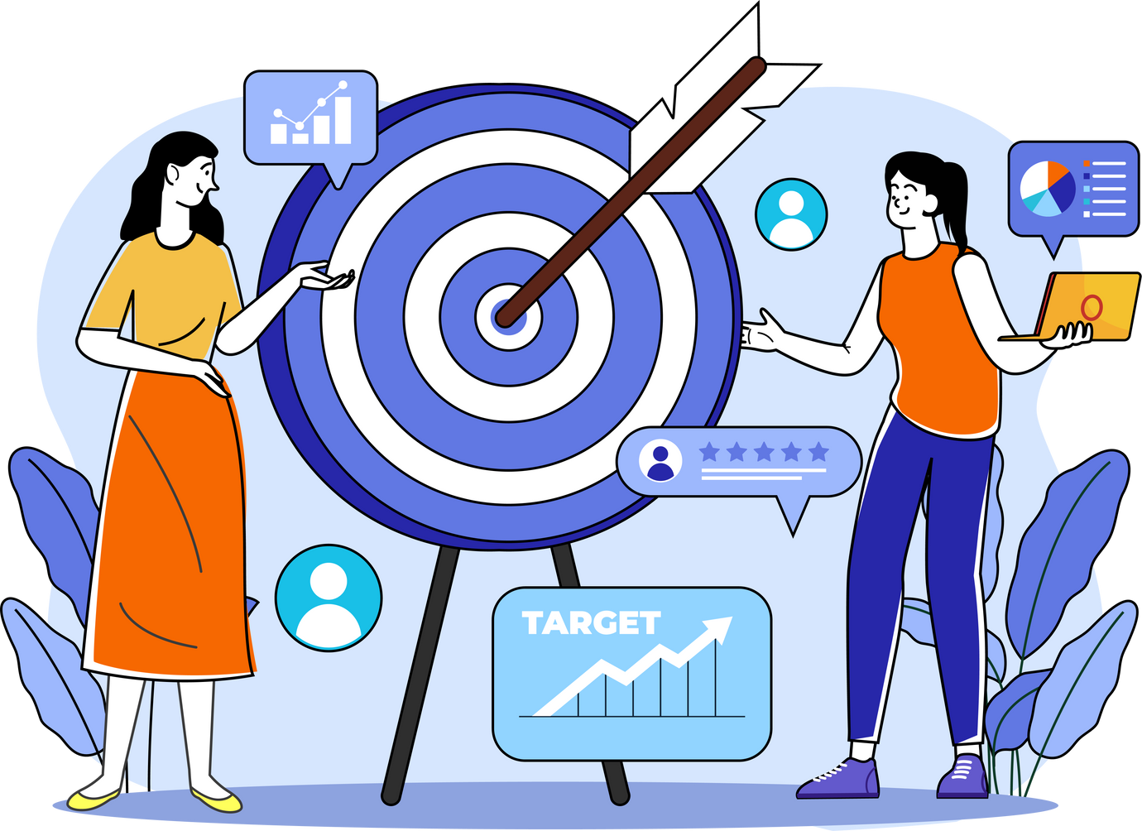
TARGET AUDIENCE
Fitness Enthusiasts: Improve form and track progress.
Beginners: Guidance on proper technique to avoid injury.
Home Workout Users: Virtual assistance with form correction.

Slide 7

PROJECT STAGES

Slide 8

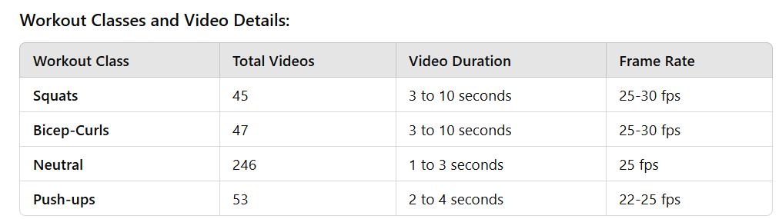
Stage 1
Data Collection
Dataset Overview
In our gym project, we compiled a comprehensive dataset of workout videos, categorizing them into four distinct classes: Squats, Bicep-Curls, Neutral, and Push-ups. The dataset was sourced from Kaggle and Pexels, providing a diverse range of examples for model training.

Slide 9
Stage 1
Features Extraction
After collecting the data, we employed MediaPipe for pose estimation, extracting key body points from each frame across all class videos. This processing resulted in a structured dataset formatted as a CSV file containing:
Feature Columns: 99 keypoint feature columns representing various body landmarks.
Target Class: Each entry is labeled with its corresponding workout class.
Total Rows: The dataset comprises a total of 57,200 rows, providing a rich source of information for training our classification model.

Slide 10



Stage 2
Pose Estimation
We are utilizing MediaPipe, a powerful cross-platform framework, for real-time pose estimation in our AI-powered fitness trainer. It is known for its efficiency and accuracy, tracking 33 key body landmarks to analyze user posture and movements during workouts.
Workout Classifiction
Automatically identify the exercises being performed by analyzing movement patterns from pose estimation data.By extracting key features like joint angles and body movement, the system compares this data to predefined templates of common exercises (e.g., squats, push-ups).

Slide 11
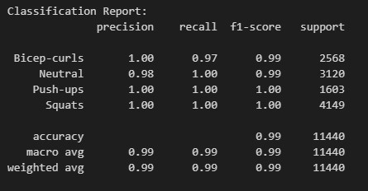
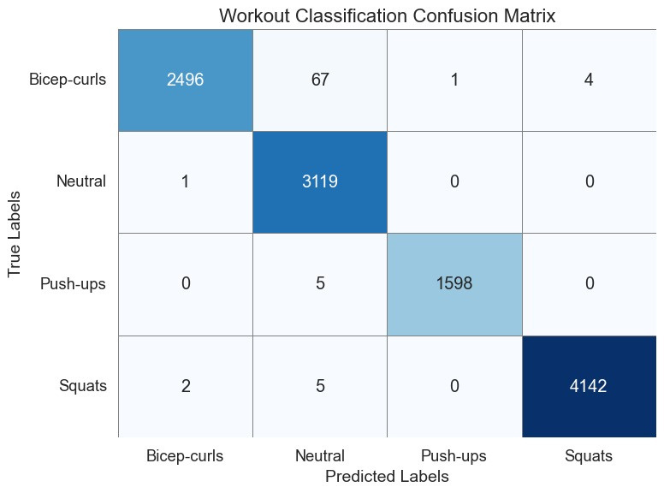
Stage 2
The Best Model
Random Forest

Slide 12
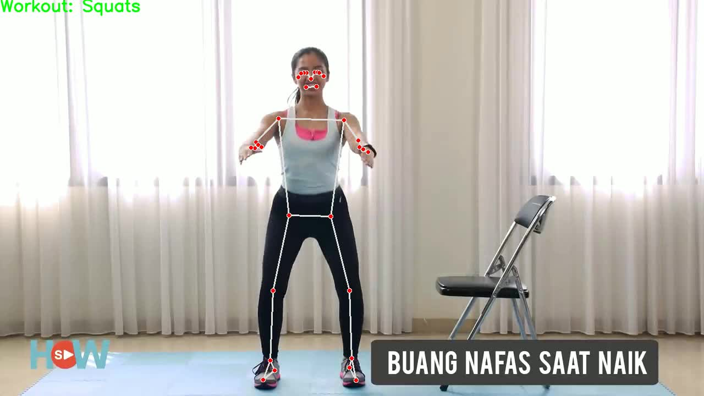
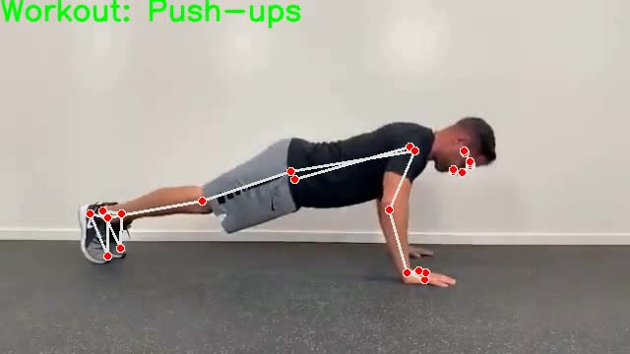
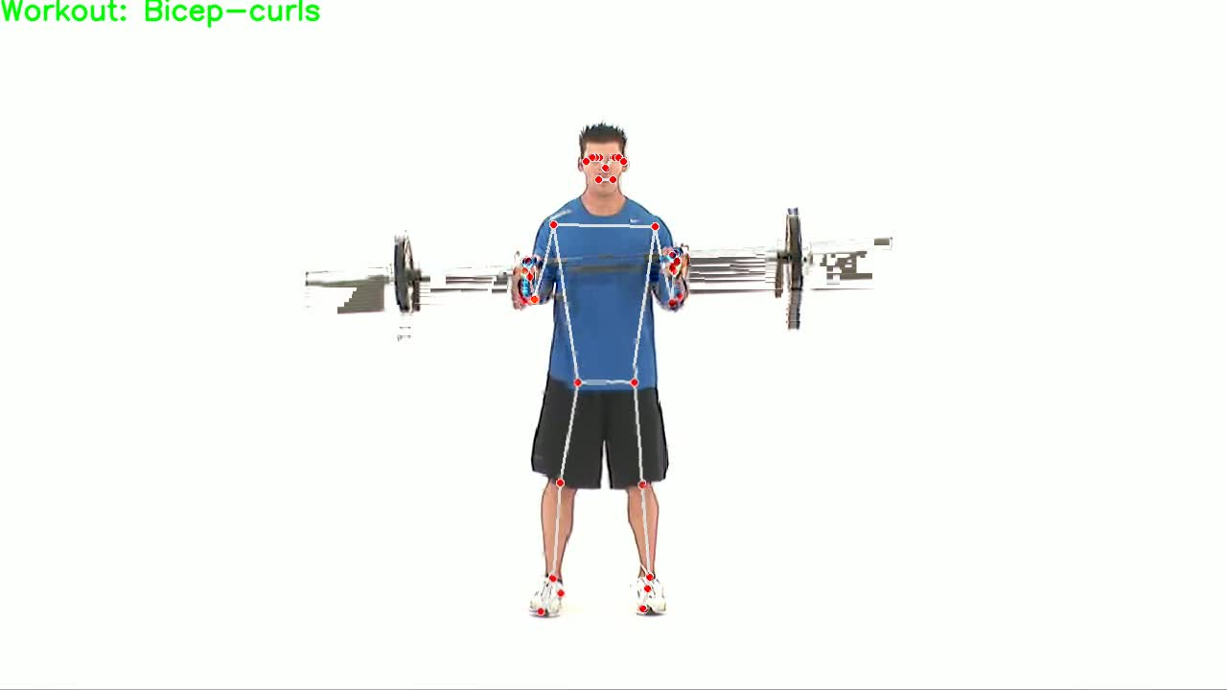

Slide 13
Stage 3
Body Orientation
Detection
Counters Start
Error Detection

Slide 14
Stage 3
Body Orientation
Detection
The orientation detection algorithm utilizes key points from the body, specifically the shoulders and elbows, to determine the user's position relative to the camera (either front-facing or side-facing). Here’s a summary of its principles:
Landmark Detection: The algorithm employs MediaPipe Pose to identify key body landmarks, particularly the left and right shoulders and elbows, serving as reference points for assessing orientation.
Distance Calculations:
The Euclidean distance between the shoulder landmarks is calculated to gauge shoulder spacing.
The distance between the shoulder and the most visible elbow (determined by visibility scores) is also computed.
Ratio Determination: A ratio of shoulder-to-shoulder distance to shoulder-to-elbow distance is calculated. A ratio exceeding a threshold (e.g., 0.6) indicates a front-facing position, while a lower ratio suggests a side-facing orientation.
Visibility Check: The algorithm includes a visibility check to focus on the most visible shoulder and elbow, ensuring reliability even with partial occlusion.

Slide 15
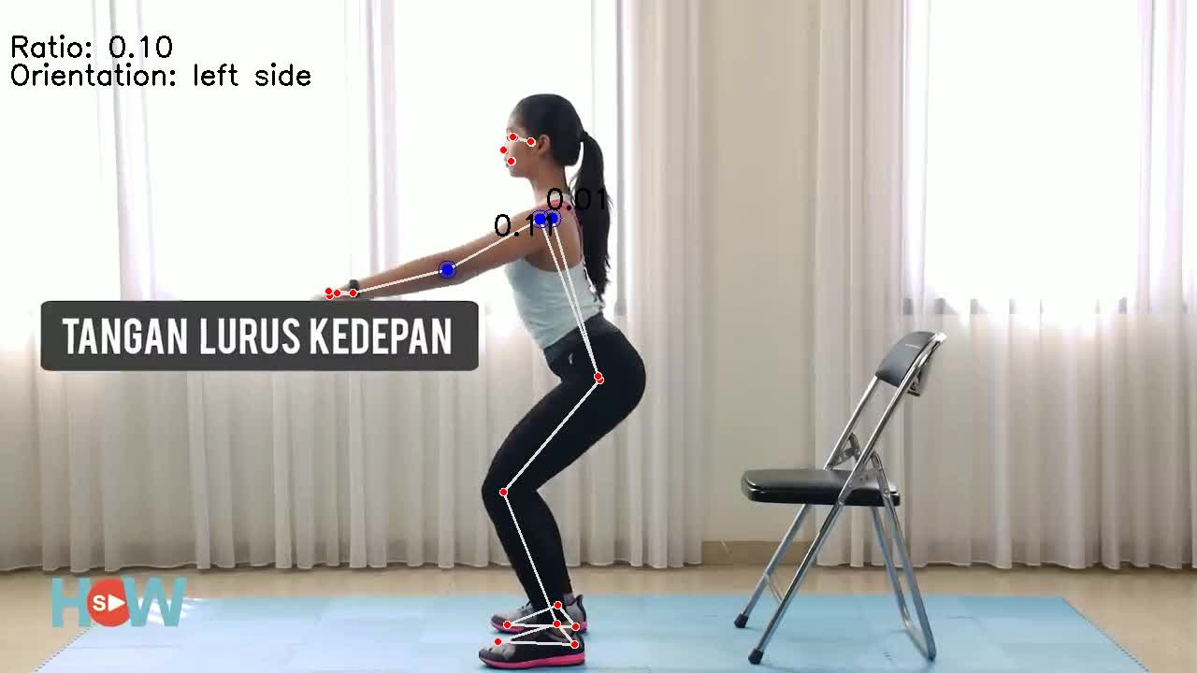
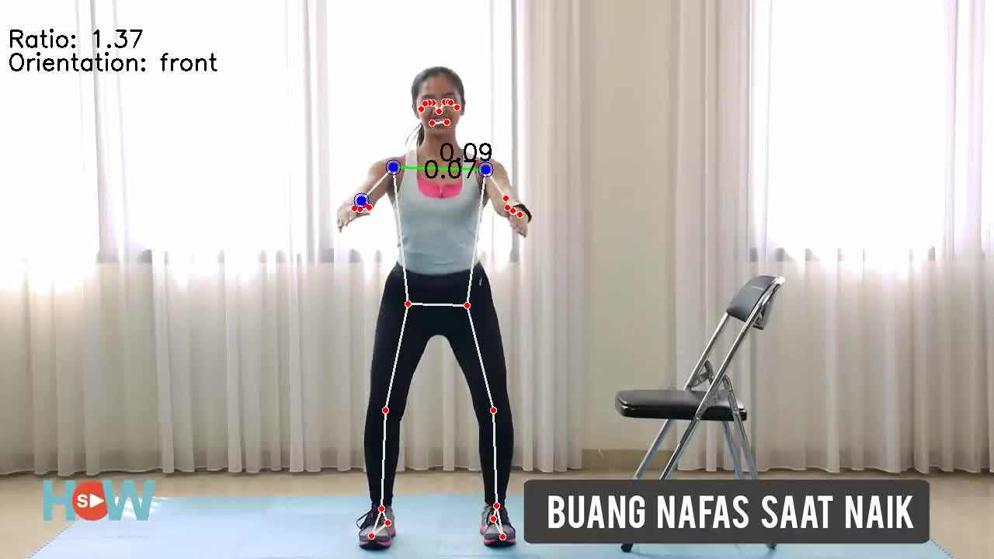
Stage 3
Body Orientation
Detection

Slide 16
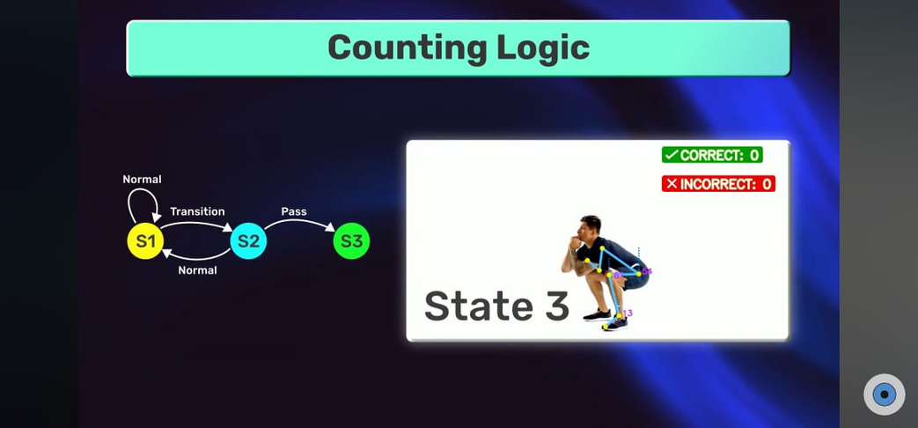
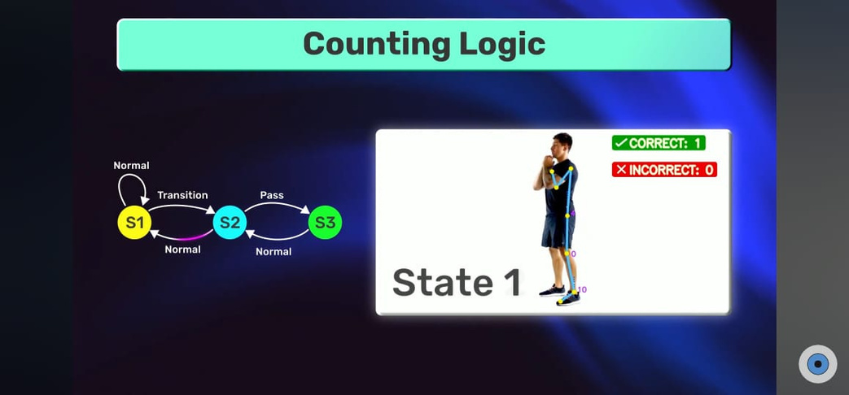
Stage 3
Counters

Slide 17
Stage 3
Error Detection
Squats:
Depth Issue: Not squatting low enough .
Back Posture: Rounding your back or leaning forward.
Knee Alignment: Knees moving inward or too far forward.
Bicep Curls:
Elbow Movement: Elbows moving during the curl.
Back Arching: Bending your back while curling.
Swinging: Swinging your body to lift weights.
Push-ups:
Hip Sagging: Hips dropping below body level.
Body Misalignment: Shoulders, hips, and ankles not aligned.
Elbow Bend: Elbows not bending enough or flaring out.

Slide 18

Stage 4
Feedback
After each exercise session, the system analyzes the number of correct and incorrect repetitions based on the user's form. It identifies areas for improvement, such as insufficient depth in squats or hip sagging during push-ups, and offers specific suggestions to correct these mistakes.

Slide 19
Stage 5
Deployment
Deployment with Streamlit
Streamlit is a powerful framework for building interactive web applications quickly and efficiently, making it an ideal choice for deploying our AI-powered fitness trainer

Slide 20

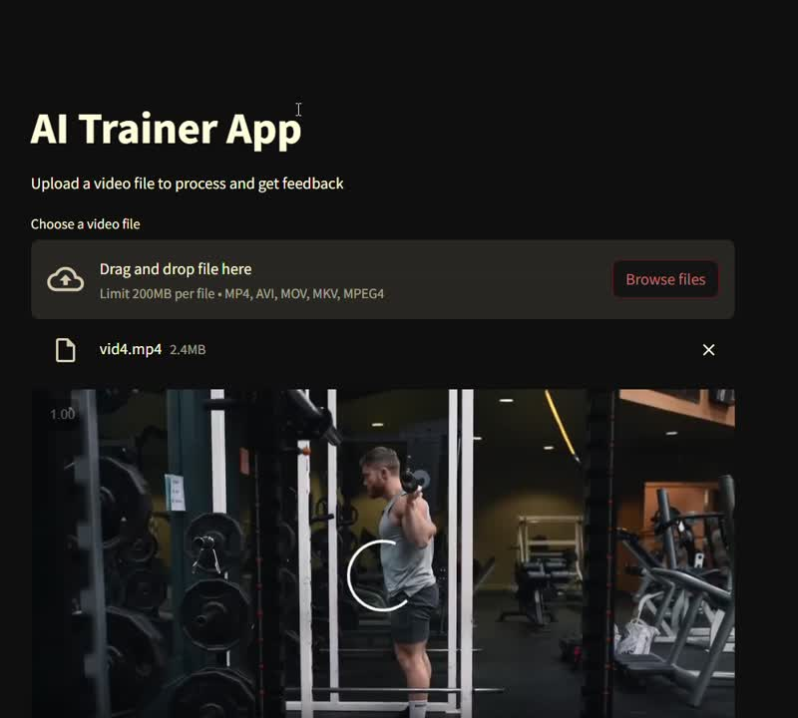

Slide 21
1
Advanced Machine Learning Algorithms:
Incorporate deeper learning models to improve exercise classification accuracy and provide more precise feedback based on user performance.
POTENTIAL FUTURE FEATURES
2
Customizable Workout Plans:
Enable users to create personalized workout plans tailored to their fitness levels, goals, and preferences. AI-driven recommendations can adjust plans based on progress and performance data.
Progress Visualization:
Enhance data visualization features to provide users with clear and insightful analytics on their fitness journey, including trends in performance, strength, and endurance over time.
3
4
Multi-Language Support:
Expand accessibility by adding multi-language support, making the application usable for a broader audience and diverse user base globally.

Slide 22
PROJECT LINK
APP LINK

Slide 23



THANK
YOU!
FOR LISTENING!

